Slide 1

OLSRv2 Simulation for MANET
Final presentation

Slide 2
Agenda
Introduction & Project Description
Optimized Link State Routing Protocol Ver. 2
Protocol Analyses.
Project Architecture.
Implementation Overview.
Questions & Open Discussion

Slide 3
Introduction &Project Description
Simulating MANET environment implementing OLSRv2 protocol
Event Driven Simulator
Three modes
Static
Dynamic
Mixed
Different station movement speeds.

Slide 4
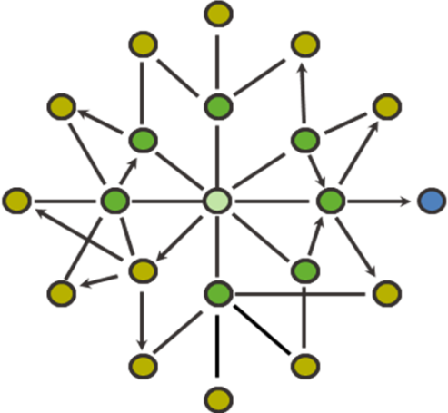
Optimized Link Status Protocol
Based on 1-hop & 2-hop Neighbors sets
Multi Point Relay set

Slide 5
Optimized Link Status Protocol
MPR
Each node notifies its MPR set for their nomination
MPRs broadcast their new role
All nodes can now build a routing table
MPR
Target
MPR
MPR
MPR
Source
MPR

Slide 6
Protocol Analyses
Put here different Graphs measurements ……

Slide 7
Protocol Analyses Cont.

Slide 8
Protocol Architecture
Log
GUI
GUI
Log
OLSR Nodes
Event Gen
Topology Mgr
Tasks Queue
Dispatcher
Tasks Queue
OLSRv2 Layer
(per node)
Event Generator
Dispatcher
Topology Manager

Slide 9
Implementation Overview
Aspects of the simulator implementation.

Slide 10
Questions
&
Open Discussion

Slide 11
Thank you !
Assaf Israel
Eli Nazarov
Asi Bross

